Slide 1
SPRING AOP
By:
Shreyas prabhu
Saikumar
Vani
Alekya
harshitha

Slide 2
Introduction
Aspect Oriented Programming (AOP) compliments OOPs in the sense that it also provides modularity. But the key unit of modularity is aspect than class.
AOP breaks the program logic into distinct parts (called concerns). It is used to increase modularity by cross-cutting concerns.
A cross-cutting concern is a concern that can affect the whole application and should be centralized in one location in code as possible, such as transaction management, authentication, logging, security etc.

Slide 3
Why use AOP?
It provides the pluggable way to dynamically add the additional concern before, after or around the actual logic. Suppose there are 10 methods in a class as given below:
class A{
public void m1(){...}
public void m2(){...}
public void m3(){...}
public void m4(){...}
public void m5(){...}
public void n1(){...}
public void n2(){...}
public void p1(){...}
public void p2(){...}
public void p3(){...}
}

Slide 4
Why use AOP?
There are 5 methods that starts from m, 2 methods that starts from n and 3 methods that starts from p.
Understanding Scenario I have to maintain log and send notification after calling methods that starts from m.
Problem without AOP We can call methods (that maintains log and sends notification) from the methods starting with m. In such scenario, we need to write the code in all the 5 methods.
Solution with AOP We don't have to call methods from the method. Now we can define the additional concern like maintaining log, sending notification etc. in the method of a class. Its entry is given in the xml file.
Where use AOP?
AOP is mostly used in following cases:
to provide declarative enterprise services such as declarative transaction management.
It allows users to implement custom aspects.

Slide 5
AspectJ Annotations
The Spring Framework recommends you to use Spring AspectJ AOP implementation, because it provides you more control and it is easy to use.
Spring AspectJ AOP implementation provides many annotations:
@Aspect
@Pointcut

Slide 6
AspectJ Annotations
The annotations used to create advices are given below:
@Before
@After
@AfterReturning
@Around
@AfterThrowing

Slide 7
Pointcut
The @Pointcut annotation is used to define the pointcut. We can refer the pointcut expression by name also.
Ex: @Pointcut("execution(* Operation.*(..))")
private void doSomething() {}

Slide 8
@Before
public class Operation{
public void msg(){
System.out.println("msg method invoked");}
}
@Aspect
public class TrackOperation{
@Pointcut("execution(* Operation.*(..))")
public void k(){}
@Before("k()")
public void myadvice(JoinPoint jp)
{
System.out.println(“before…….");
}
}

Slide 9
@Before
public class Test{
public static void main(String[] args){
ApplicationContext context = new ClassPathXmlApplicationContext("applicationContext.xml");
Operation e = (Operation) context.getBean("opBean");
System.out.println("calling msg...");
e.msg(); } }
OUTPUT:
calling msg...
before…….
msg() method invoked

Slide 10
@After
@Aspect
public class TrackOperation{
@Pointcut("execution(* Operation.*(..))")
public void k(){}
@After("k()")
public void myadvice(JoinPoint jp) {
System.out.println(“after …….");
} }
OUTPUT:
calling msg...
msg() method invoked
after …….

Slide 11
@AfterReturning
public class Operation{
public int m(){
System.out.println("m() method invoked");
return 2;
} }
@Aspect
public class TrackOperation{
@AfterReturning(
pointcut = "execution(* Operation.*(..))",
returning= "result")
public void myadvice(JoinPoint jp,Object result)
{
System.out.println(“after returning……");
}
}

Slide 12
@AfterReturning
public class Test{
public static void main(String[] args){
ApplicationContext context = new ClassPathXmlApplicationContext("applicationContext.xml");
Operation e = (Operation) context.getBean("opBean");
System.out.println("calling m...");
} }
Output:
calling m...
m() method invoked
after returning……
2

Slide 13
@Around
public class Operation{
public void msg(){System.out.println("msg() is invoked");
}
@Aspect
public class TrackOperation
{
@Pointcut("execution(* Operation.*(..))")
public void abcPointcut(){}
@Around("abcPointcut()")
public Object myadvice(ProceedingJoinPoint pjp) throws Throwable {
System.out.println("Before calling actual method");
Object obj=pjp.proceed();
System.out.println("After calling actual method");
return obj;
} }

Slide 14
@Around
public class Test{
public static void main(String[] args){
ApplicationContext context = new classPathXmlApplicationContext("applicationContext.xml");
Operation op = (Operation) context.getBean("opBean");
op.msg();
} }
Output:
Before calling actual method
msg() is invoked
After calling actual method

Slide 15
@AfterThrowing
public class Operation{
public void validate(int age)throws Exception{
if(age<18){
throw new ArithmeticException("Not valid age");
}
else{ System.out.println("Thanks for vote");
} } }
@Aspect
public class TrackOperation{
@AfterThrowing( pointcut = "execution(* Operation.*(..))",
throwing= "error")
public void myadvice(JoinPoint jp,Throwable error) {
System.out.println("after throwing……..");
} }

Slide 16
@AfterThrowing
public class Test{
public static void main(String[] args){
ApplicationContext context = new ClassPathXmlApplicationContext("applicationContext.xml");
Operation op = (Operation) context.getBean("opBean");
System.out.println("calling validate...");
try{
op.validate(19);
}catch(Exception e){System.out.println(e);}
System.out.println("calling validate again...");
} }
OUTPUT:
calling validate...
Thanks for vote
calling validate again...
after throwing……..

Slide 17
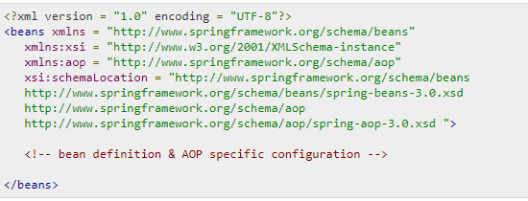
XML Schema Based AOP
To use the AOP namespace tags, we need to import the spring AOP schema as described −

Slide 18
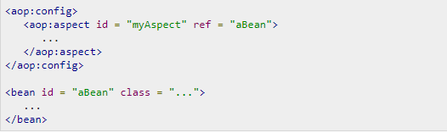
Declaring an aspect
An aspect is declared using the <aop:aspect> element, and the backing bean is referenced using the ref attribute as follows −
Here "aBean" will be configured and dependency injected just like any other Spring bean

Slide 19
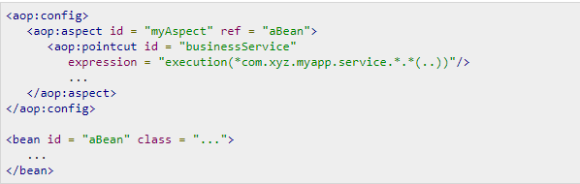
Declaring a Pointcut
A pointcut helps in determining the join points (i.e methods) of interest to be executed with different advices. While working with XML Schema-based configuration, pointcut will be defined as follows −

Slide 20
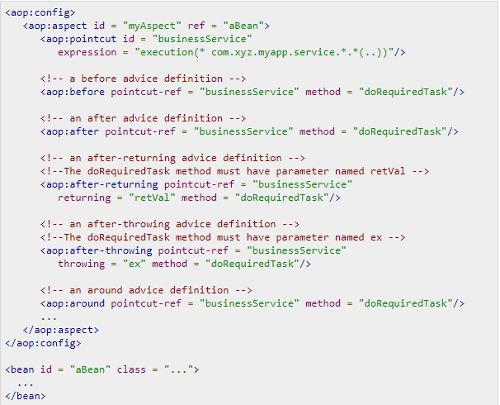
Declaring Advices
You can declare any of the five advices inside an <aop:aspect> using the <aop:{ADVICE NAME}> element as given below −

Slide 21
Logging with AspectJ
What is Slf4j?
SLF4J stands for Simple Logging Facade for Java.
It provides a simple abstraction of all the logging frameworks.
It enables a user to work with any of the logging frameworks such as Log4j, Logback, JUL (java.util.logging), etc. using single dependency.
You can migrate to the required logging framework at run-time/deployment time.

Slide 22
Logging with AspectJ
SLF4J - Logging Frameworks
Logging in programming, refers to recording activities/events. Usually, the application developers should take care of logging.
A logging framework usually contains three elements
Logger
Formatter
Handler
Logger Object:
To log a message, the application sends a logger object (sometimes along with the exceptions if any) with name and security level.

Slide 23
Logging with AspectJ
Severity Level
Fatal
Error
Warning
Info
Debug
Trace

Slide 24
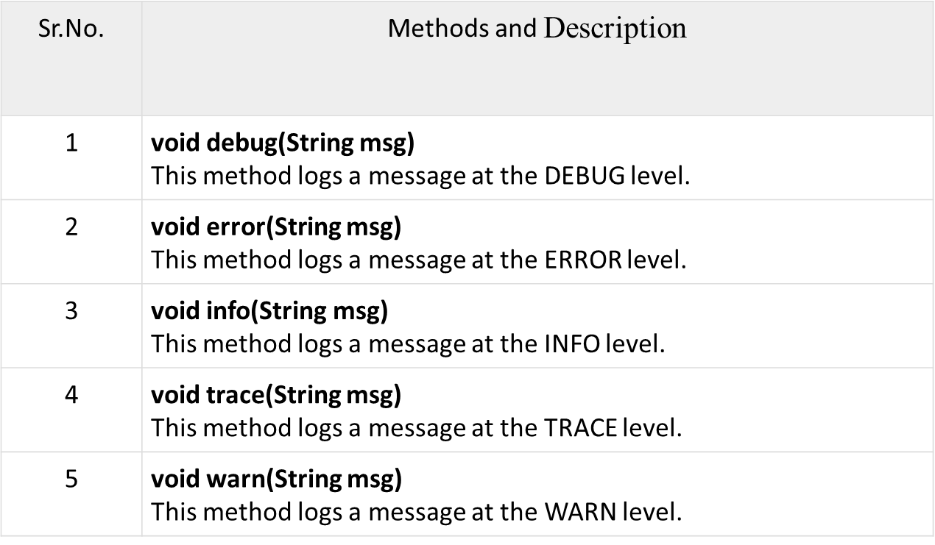
Logging with AspectJ
Logger Interface
The logger interface of the org.slf4j package is the entry point of the SLF4J API. The following lists down the important methods of this interface.

Slide 25
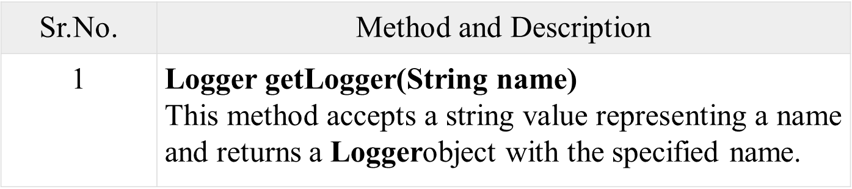
Logging with AspectJ
LoggerFactory Class:
The LoggerFactory class of the org.slf4j package is a utility class, which is used to generate loggers for various logging APIs such as log4j, JUL, NOP and simple logger.

Slide 26
Logging with AspectJ
A simple basic logger program using SLF4J
Step 1 - Create an object of the slf4j.Logger interface Since the slf4j.Logger is the entry point of the SLF4J API, first, you need to get/create its object
The getLogger() method of the LoggerFactory class accepts a string value representing a name and returns a Logger object with the specified name.
Syntax:
Logger logger = LoggerFactory.getLogger(“SampleLogger”);
Step 2 - Log the required message
The info() method of the slf4j.Logger interface accepts a string value representing the required message and logs it at the info level.
Syntax:
Logger.info(“Hii this is my first project”);

Slide 27
THANK YOU

